Slide 1

Corporate Solution Confidential
www.corporatesolution.co.in
+91 9594441736

Slide 2
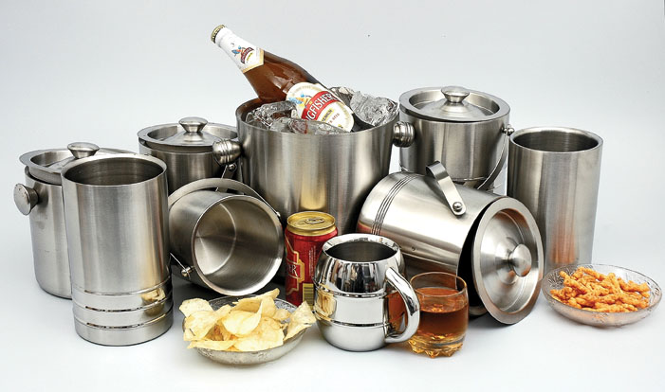
Corporate Solution Confidential
www.corporatesolution.co.in
+91 9594441736

Slide 3
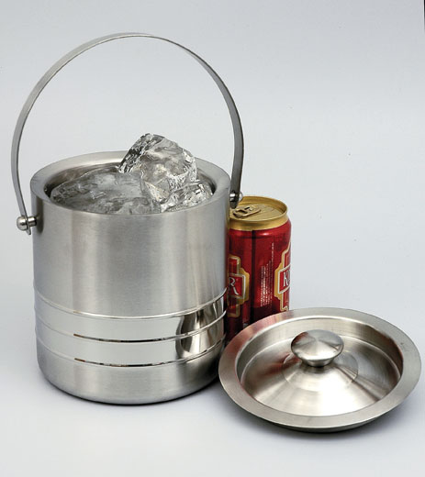
Corporate Solution Confidential
Ice Bucket : Size 12*13 , 1 Ltr—Price 195/-
+91 9594441736 www.corporatesolution.co.in

Slide 4
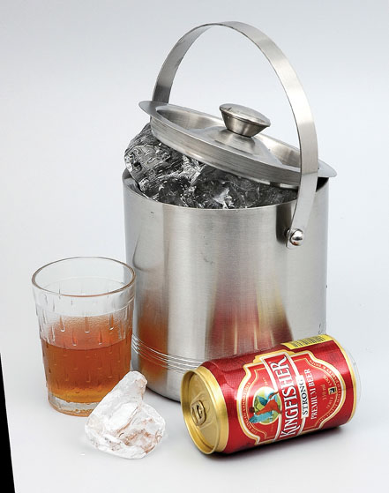
Corporate Solution Confidential
Ice Bucket : Size 15 1/2*15 1/2 , 1.5 Ltr—Price 241/-
+91 9594441736 www.corporatesolution.co.in

Slide 5
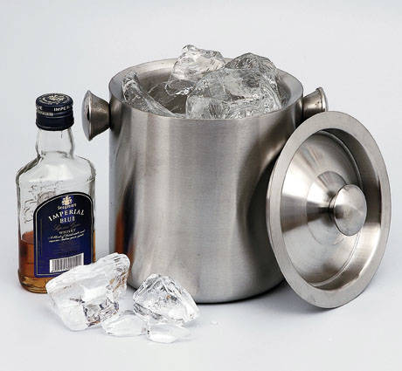
Corporate Solution Confidential
Ice Bucket : Size 17*18 , 3 Ltr—Price 371/-
+91 9594441736 www.corporatesolution.co.in

Slide 6
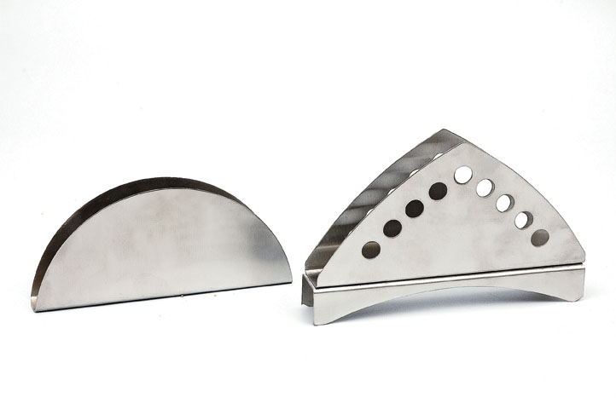
Corporate Solution Confidential
Tissue Stand :Round Rs -42/-,Triangular 65/-
+91 9594441736 www.corporatesolution.co.in

Slide 7
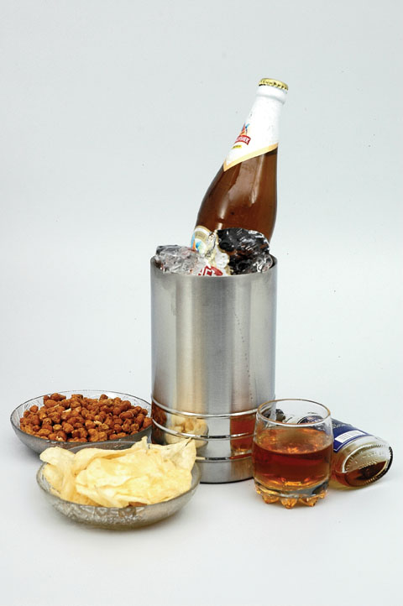
Corporate Solution Confidential
. Wine Cooler : Size 12*18 ,—Price 163/-
+91 9594441736 www.corporatesolution.co.in

Slide 8
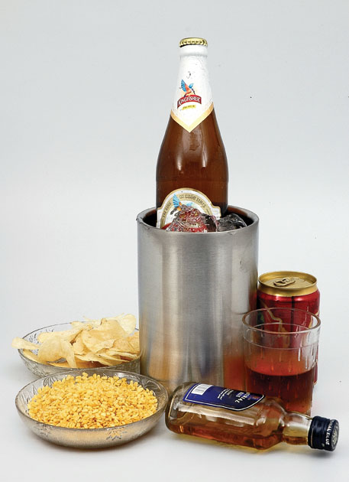
Corporate Solution Confidential
Wine Cooler : Size 12*20 ,—Price 180/-
+91 9594441736 www.corporatesolution.co.in

Slide 9
Corporate Solution Confidential
Thank you!!!!!!!
Visit us at: www.corporatesolution.com
+91 9594441736

